Slide 1
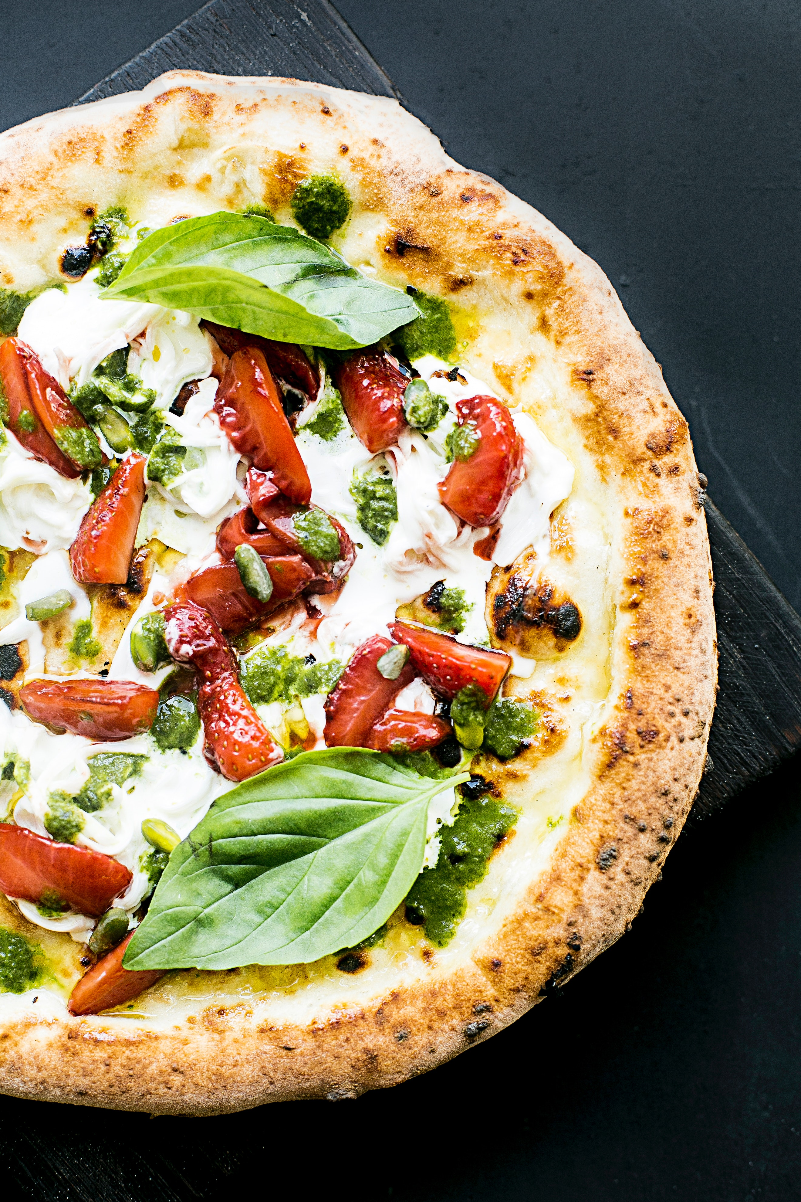
Accelerating A+ Pizza’s Growth
A Proposal Presented by A+ Data
Presented to Preeti Raman, CEO of A+ Pizza
(Group 10 - CSDA 1030)
Hayley Easto, Xiaoman (Sherry) Lu, Beata Olejnik, Joseph Opuni-Mensah, Kimberly Prideaux, Nathasha Vyas

Slide 2
AGENDA
Introduction
Background
Problem Statement
Objectives /Success Criteria
Assumptions
Approach /Project Plan

Slide 3
INTRODUCTION
A+ Pizza is a successful restaurant in Toronto.
You, the owners, want to generate growth in your business.
We, A+ Data, have been hired to put together a data-driven analysis for this growth initiative.
Let’s accelerate A+ Pizza’s growth together!

Slide 4
BACKGROUND ON A+ PIZZA
Your current business model includes the following services:
customer takeout
home delivery
dine-in.
Your current menu includes:
Pizza
Salads
Alcoholic beverage
Non-alcoholic beverages
You have amazing word-of-mouth reviews on your quality and flavour

Slide 5
PROBLEM STATEMENT
Generate business growth at A+ Pizza by:
Implementing a social media platform
Opening 3 new restaurants by 2021
Increasing profitability at the flagship location

Slide 6
Objective 1 Increase brand recognition/loyalty
Strategic Decision:
Implement a social media platform
Tactical Decisions:
Explore data on UberEats, Skip the Dishes and other delivery companies
Explore data about social media marketing & promotion campaigns
Source developer for Smartphone app – any joint apps available
Explore data for other loyalty programs – PCOptimum, McDonald’s, Tim Hortons, Pizza Pizza
Explore data for pizza restaurant online ordering – Pizza Hut, Domino’s, Pizza Pizza
Explore data on health and wellness as it relates to restaurant food
Hire social media marketer – explore data on results from potential candidates

Slide 7
Objective 1 (cont’d)
Operational Decisions:
Costs related to social media campaign, Smartphone app, website
Reliability of the app/ volume capability for website
Customer satisfaction results for app & website
Customer satisfaction results from current eat-in, delivery, take-out services
Additional staffing & product needs during launch
Security precautions for customer data
Success Criteria:
30% of sales come from app/social media/loyalty program by 2021

Slide 8
Objective 2 Grow Overall Business Sales
Strategic Decision:
Open 3 new restaurant locations by 2021
Tactical Decisions:
Evaluate data on commercial real estate rental rates & available properties
Explore data about demographics of target areas
Explore data about competitors in target areas - menu prices, sales, offerings
Explore costs of moving, renovation and setup of new restaurant
Research contractors & hire – pricing, previous projects, results
Order equipment needed for new location – list based on what is used in current location
Hire employees for new locations – analyze data on wages, staffing levels, job descriptions
Set up suppliers – using current suppliers or research any new ones needed based on location/costs/scheduling
Order other supplies (food, operating supplies) – project product sales based on current store/local competitors/new location
Decide on marketing/promotional needs for new store opening - evaluate results of current store promotions/competitor offers

Slide 9
Objective 2 (cont’d)
Operational Decisions:
Costs related to real estate rents, taxes, legal, realtor
Costs of moving, renovation and setup of new restaurant
Costs and reliability of contractor – client satisfaction with previous projects
Projected product and equipment needs and costs
Costs, reliability, and quality of suppliers for food and beverage products
Security precautions are needed for new locations during and after renovations
Success Criteria:
Increase overall sales to $5,000,000 by 2021

Slide 10
Objective 3 Increase overall profitability
Strategic Decision:
Increase profitability in location 1
Tactical Decisions
Improve efficiency in lifecycle/handling of products - food, liquor
Evaluate amount of each product used in each dish
Analyze data for amount of expected waste/shrinkage – theft, yields, accurate ordering/delivery
Evaluate current costs for opportunities - cleaning, laundry, accounting and credit card fees, supplies,
Analyze current energy and water efficiency results
Evaluate current staffing levels/wages for opportunities
Evaluate data on historical maintenance and repair costs
Conduct research with current customers to discover their ideas for improvement
Evaluate current results for take-out segment of business
Research historical and competitor data regarding promotions for pickup/takeout
Research demographics/competitor data regarding implementing a catering program

Slide 11
Objective 3 (cont’d)
Tactical Decisions (continued):
Evaluate interest from schools of lunch program
Evaluate current results for home delivery segment of business
Evaluate costs/competitors/demographics regarding increasing delivery area
Research historical and competitor data regarding special delivery promotions
Evaluate current results for dine-in segment of business
Analyze costs/benefits regarding expanding current restaurant or adding a patio
Evaluate competitor results & customer interest in adding new menu items
Analyze demographics/competitor results/customer interest in adding buffet or all-you-can-eat program to current location

Slide 12
Objective 3 (cont’d)
Operational Decisions:
Analyze current food and beverage yields for ways to improve
What are the expected waste & shrinkage costs due to theft, ordering & delivery accuracy
Evaluate historical profit & loss statements for cost saving opportunities
Research historical and competitor data regarding promotions for pickup/takeout
Costs & benefits involved in setting up school lunch program
Costs & benefits involved in increasing delivery area
Costs & benefits involved in expanding current location and adding a patio
Costs & benefits involved in adding buffet or all-you-can-eat programs
Costs & benefits involved in adding new menu items
Success Criteria:
Combined food/beverage costs at 30% or below

Slide 13
ASSUMPTIONS
The is no social media presence for the business.
There is no tracking mechanism for all orders made currently.
The is no data for the demographics of the customers in their operation area.
The taxation rates for this business category will not change from now till 2021.(That can affect our sales and profitability).
The pizza business is operating within one of the cities of the GTA.
The is currently no process for collecting feedback from the customers.
The owners have secured funding from a Financial Institution for the expansion and increase in profitability project.
The data to be used is complete and accurate.
The internal datasets are spreadsheets.

Slide 14
APPROACH & PROJECT PLAN
Receive/Understand Requirements
Current State Assessment
Target Model
Recommendations
Roadmap
Implementation Planning

Slide 15
APPROACH
Receive/ Understand Requirements
Current State Assessment
Implementation Planning
Find Datasets
Target Model
Recommend-ations
Roadmap
Extract, Transform, Load
Evaluate/ Review

Slide 16
Receive/Understand Requirements
Objective:
develop working relationship between A+ Pizza & A+ Data
agree on project scope and objectives
Method:
meet with stakeholders
identify resources
identify key dates
validate objectives
review existing documentation
Schedule key meetings
finalize project definition and plan
Output:
Align A+ Data and A+ Pizza stakeholders on project scope and objectives

Slide 17
Current State Assessment
Objective:
assess current state of processes and resources,
identify current issues/initiatives
Methodology:
market assessment,
competitor analysis,
current business analysis
Input Historical Data:
Financial information
Staff hiring and performance
Supplier performance
Energy use
Customer satisfaction
Safety
Marketing and promotions
Health inspection
Inventory management
Menu items
Customer order
Customer delivery
Output:
Current Status of Business, Market Analysis, Competitor Analysis

Slide 18
Find Datasets
.
Analysts will be responsible for each looking into public datasets pertaining to the different objectives, for example:
Hayley and Nathasha will be looking into sourcing social media datasets from Yelp and Twitter
Beata and Kimberly will be looking into geographic datasets to determine areas where there is a lack of pizza restaurants
Joseph and Sherry will be looking into general business expansion statistical datasets

Slide 19
Target Model
Objective:
create a visual description of business process informational needs
Method:
identify dimensions relating to business process
identify metrics/facts that relate,
document relationships between metrics & dimensions
Identify fields needed for subject area
Output:
Dimensional model
Entity Relationship Diagram for model
Data Definition Language for each dimension/fact table

Slide 20
Target Model (cont’d)
Extract/Transform/Load Mapping
Identify Source Systems, source tables, source fields
Identify Target Tables /fields
Define the Type of data warehouse table (fact/dimension)
Define/Identify Grouping Logic - Filters, Column Order/Type, Data Type/Length/Precision/Scale
Define Transformation Logic (rules)
Define Default values for Null attributes, keys, metrics
Outputs:
ETL Mapping Document
Metadata for the Data Warehouse environment
Data Dictionary
Data model reviews:
Ensure data model meets business requirements
check data for consistency and completeness

Slide 21
Recommendations
Objective
Evaluate Target Model
Form recommendations
Roadmap
Objective
Create a roadmap for key initiatives
Implementation Planning
Objective
Define long term plan and identify key milestones
Define budgetary requirements

Slide 22
Project Plan
By September 26, 2019
Understand Business and Business Problem
September 27 – October 3, 2019
Current State Assessment
October 4 – 10, 2019
Identify architecture
October 11 – 17, 2019
October 18 – 20, 2019
October 21, 2019
October 22 – 27, 2019
Generate Action Plan In Team
Identify Team Member Strengths and Applicable Experience
Develop and Submit Proposal
Present Overview of Findings and Deliverables to A+ Pizza
Address Questions from A+ Pizza and Integrate Responses into Deliverables
Submit Final Deliverables
Mobiliz-ation
Data Provision-ing and Exploration (find new datasets, review existing internal data)
Require-ments Definition
Target Model
Recommendations
Roadmap
Implement-ation Planning
Prepare Deliverables and Present-ation

Slide 23
We Look Forward to Helping You Accelerate Your Company’s Growth

